Slide 1
Case Study in Video Analytics
Cricket Shot Prediction

Slide 2
Contents
Cricket Shot Prediction – Model Training and Testing
Approaches to building Classifiers from Video data
Approaches used for Cricket Shot Prediction
Cricket Shot Prediction - Model Deployment

Slide 3
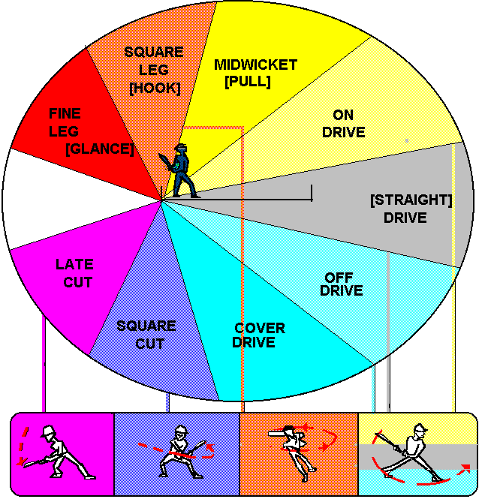
Cricket Shot Prediction
In cricket, various types of shots played by a batsman are identified
Drive
Leg Glance or Flick shot
Sweep Shot
Pull Shot
Hook
Cut Shot
Objective: Developing a cricket shot prediction model using video analytics
Videos of the batsmen playing a shot are used as input

Slide 4
Formulation
Formulation: Classification problem with each type of shot considered as a class
Relation between video and class of shot to be learnt from data
Classifier
Input-Output Relation
Output class
(Type of cricket shot)
Input
(Video of batsman playing cricket shot)
Feedback: Input-Output data

Slide 5
Step 3: Build Classifier
Data Collection
Collect relevant data along with class label
Data Preparation
Clean the data and fill any missing values
Pre-process the data as necessary
Build Classifier
Train classifier by learning relation between input features and output classes

Slide 6
Approaches to Building Classifier on Videos
Frame Based Approaches
Sequences Based Approaches
3D CNN based Approaches
Attention Mechanism based Approaches
Different architectures have been developed based on each of the above approaches to learn from videos

Slide 7
Approaches to Building Classifier on Videos
Frame Based Approach:
Frames are extracted from videos
CNNs are used to extract useful features from each frame
Features across all frames are used to make final predictions
Challenges:
Treating each frame independently results in loss of temporal information
Long term dependencies cannot be captured

Slide 8
Approaches to Building Classifier on Videos
Sequences based Approaches:
Recurrent Neural Networks can capture temporal dependences by taking a sequences of frames as input

Slide 9
Sequence Learning

Slide 10
Sequence Learning
Sequence learning is where a computer needs to learn from a sequence of inputs and/or produce a sequence of outputs
Successive inputs might be dependent on one another
Size of the input sequence is not fixed
Examples of Sequence Learning Tasks:
Sentiment analysis - Input: Sequence of words | Output: positive/negative sentiment
Describing or Classifying a video - Input: Video (sequence of images) | Output: Class or Sequence of words
Machine Translation - Input: Sequence of words in one language | Output: Sequence of words in another language

Slide 11
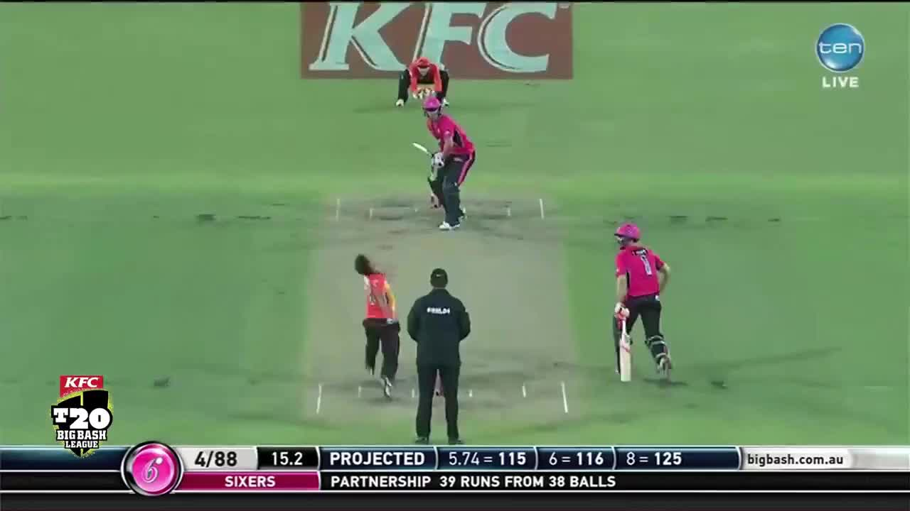
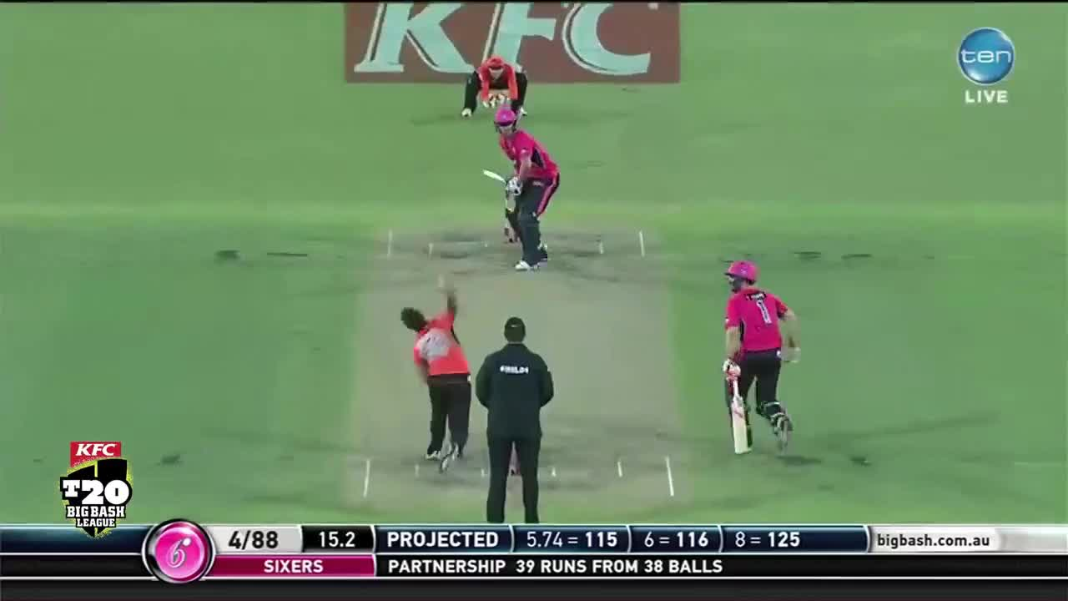
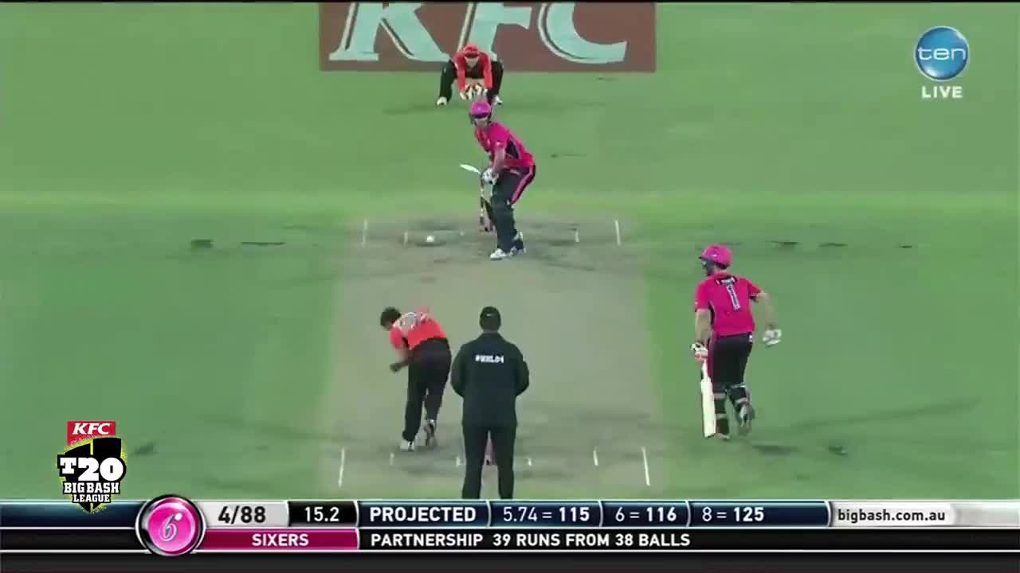

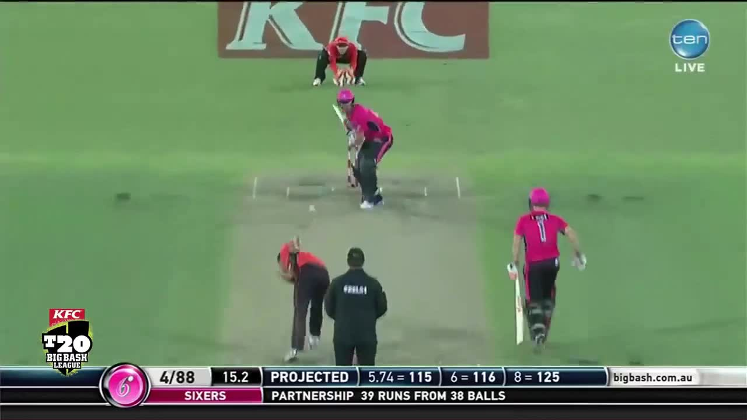
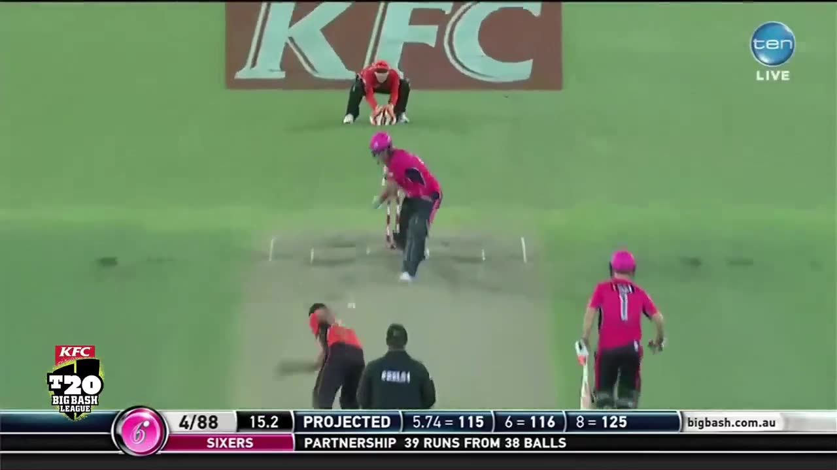
Sequence Learning – Video Classification

Slide 12






Sequence Learning – Recurrent Neural Networks
Single or Sequence of outputs
Sequence of simple networks are joined together to form a recurrent network
Recurrent connection is added between them to capture dependency of inputs
Information from multiple is encoded together and then decoded in necessary form
Also known as encoder-decoder models
$$y$$
Recurrent connection
$$…..$$
$$x_{1}$$
$$x_{2}$$
$$x_{3}$$
$$x_{n}$$
Encoded sequence of inputs (words or images)

Slide 13






Sequence Learning – Recurrent Neural Networks (RNN)
$$y$$
For a video, encoded values are obtained by passing frames of video through a CNN
So the features extracted from CNN are given as inputs to RNN
Recurrent connection
$$…..$$
$$x_{1}$$
$$x_{2}$$
$$x_{3}$$
$$x_{n}$$
CNN
CNN
CNN
CNN

Slide 14
Approaches to Building Classifier on Videos
Attention Mechanism over Sequence Learning
Sequence learning is more effective when used together with attention mechanism
Motivation for Attention Mechanism:
Consider the use case of machine translation
Encoder reads the sentence once and encodes it
Decoder uses this encoded information to produce a sequence of translated words
However, it would be helpful to focus on on different words while producing output sequence
Input sequence
What
is
your
name
Aapka
naam
kya
hai
Output sequence
Attention mechanism enables system to focus on parts of encoded information while decoding

Slide 15
Approaches to Building Classifier on Videos
Sequences based Approaches:
Recurrent Neural Networks can capture temporal dependences by taking a sequences of frames as input
Challenges:
Learning is difficult due to high computation requirement
Learning is very time consuming

Slide 16
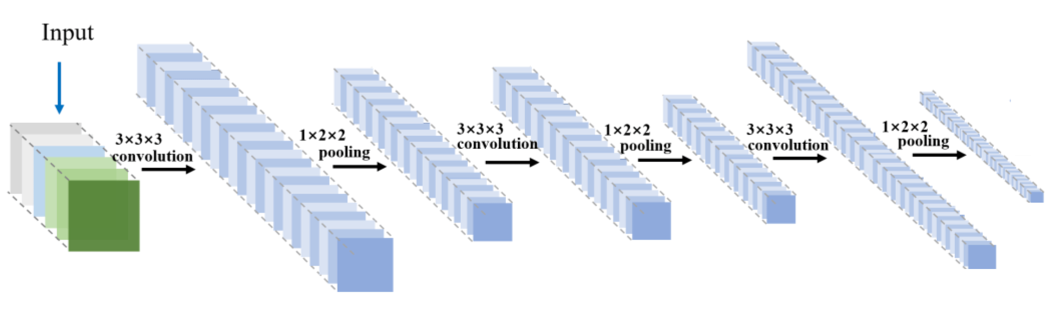
Approaches to Building Classifier on Videos
3D Convolution Neural Networks:
3D CNNs consider both spatial and temporal information in videos simultaneously while learning
Operate on spacio-temporal cubes of data

Slide 17
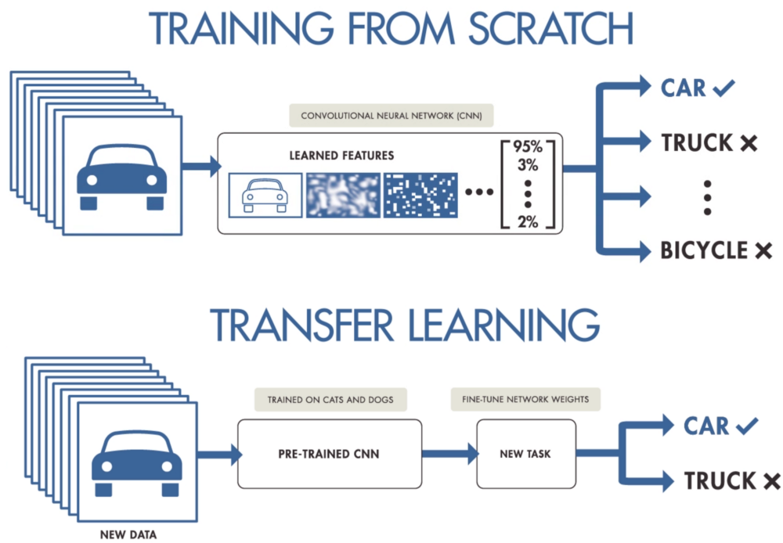
Transfer Learning
Transfer learning involves re-using a trained model
Model is then tuned to the task at hand
Transfer learning can also be used when training models on video data

Slide 18
Approaches Used for Cricket Shot Prediction

Slide 19
Approaches Used for Cricket Shot Prediction
To reduce computation load, only 10 frames from each video were used for training the classifiers
Sequence Learning Based Approach
2D CNN + LSTM Network build from scratch
CNN to extract spatial features from the frames of the video
LSTM to extract temporal features from the video
Transfer Learning on Pre-trained model
VGG16 network (CNN+RNN) is used
Model is pre-trained to recognise actions or activities in videos
Some layers of this network are tuned using the cricket shot videos

Slide 20
Step 4: Test Classifier
Data Collection
Collect relevant data along with class label
Data Preparation
Clean the data and fill any missing values
Pre-process the data as necessary
Build Classifier
Train classifier by learning relation between input features and output classes
Test Classifier
Assess the classifier performance

Slide 21

Confusion matrix and Accuracy
A table or a matrix with different combinations of predicted and actual values for different classes
Used to track the number of correctly and wrongly predicted samples by the classifier
 | Predicted Class 1 | Predicted Class 2
Actual Class 1 | Correctly classified | Incorrectly classified
Actual Class 2 | Incorrectly classified | Correctly classified
$$Accuracy=\frac{No. of Correctly Classified Images}{Total No. of Images}$$

Slide 22
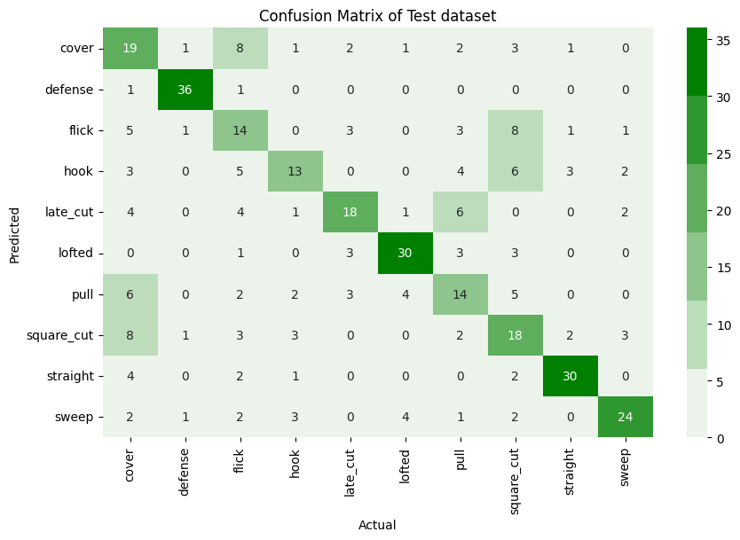
Confusion Matrix for 2D CNN+LSTM
On test set of 378 videos

Slide 23
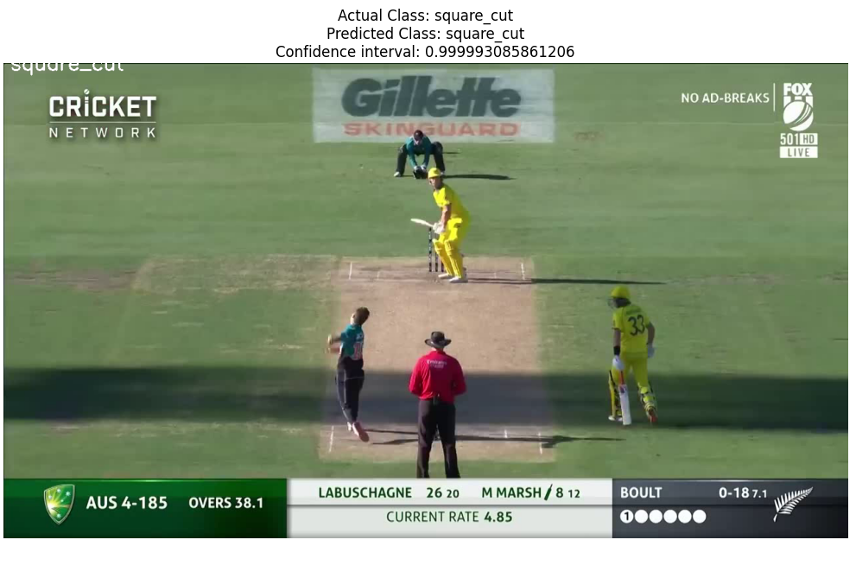
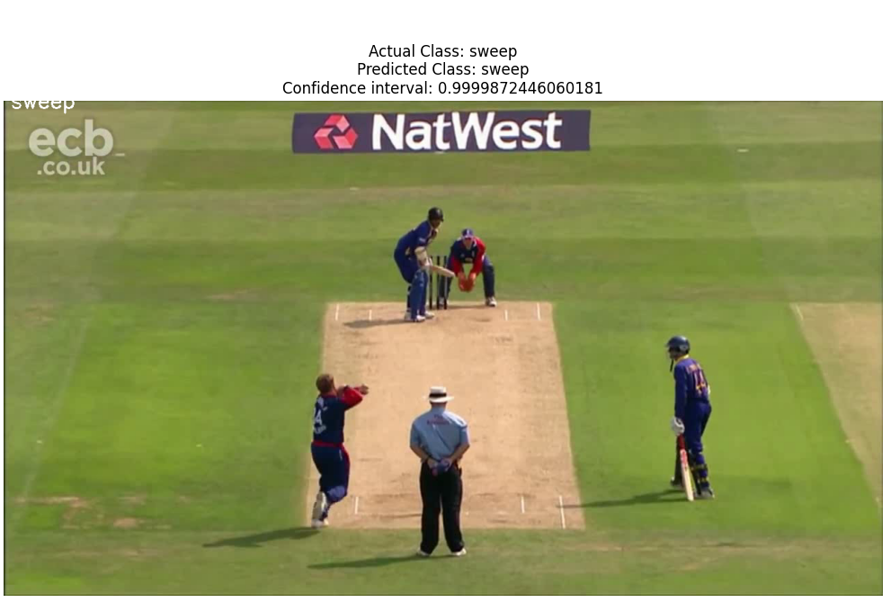
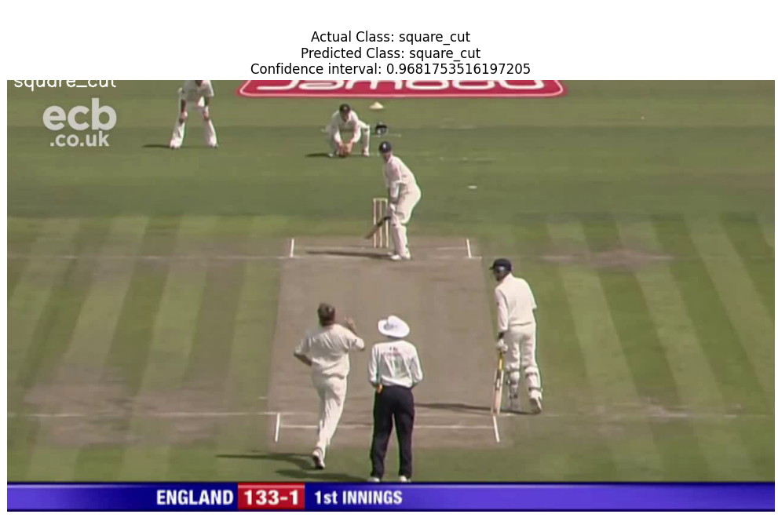
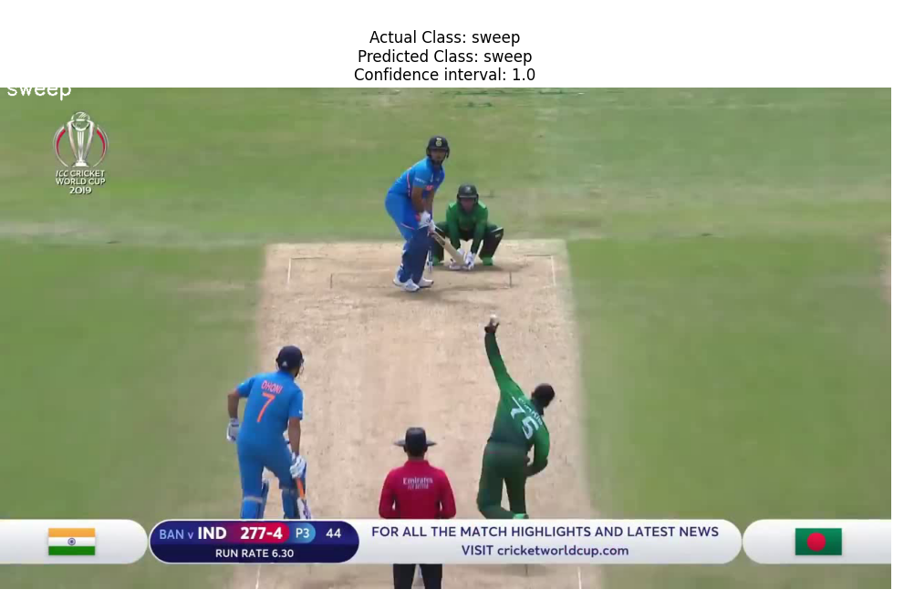
Videos Correctly Classified

Slide 24

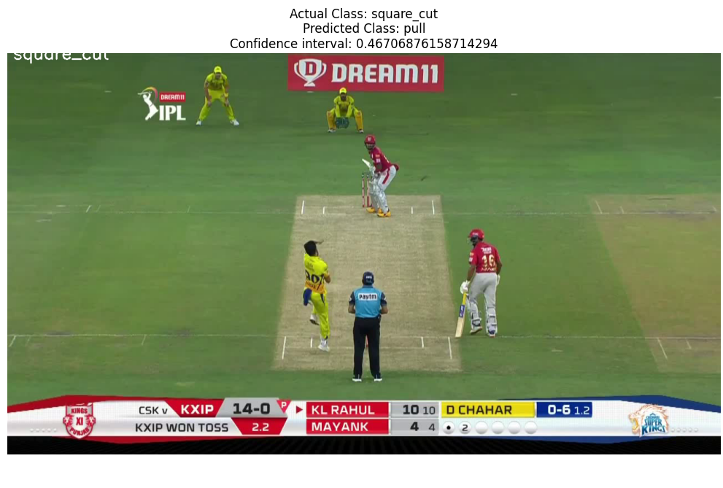
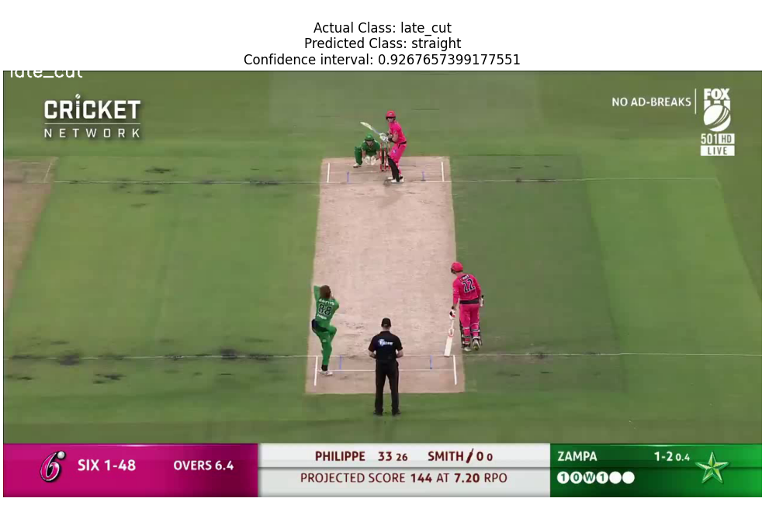
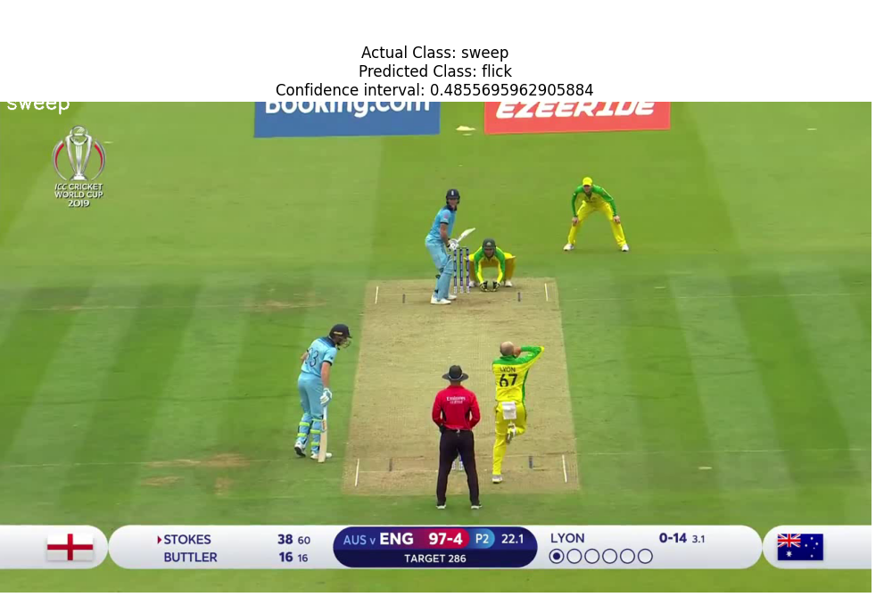
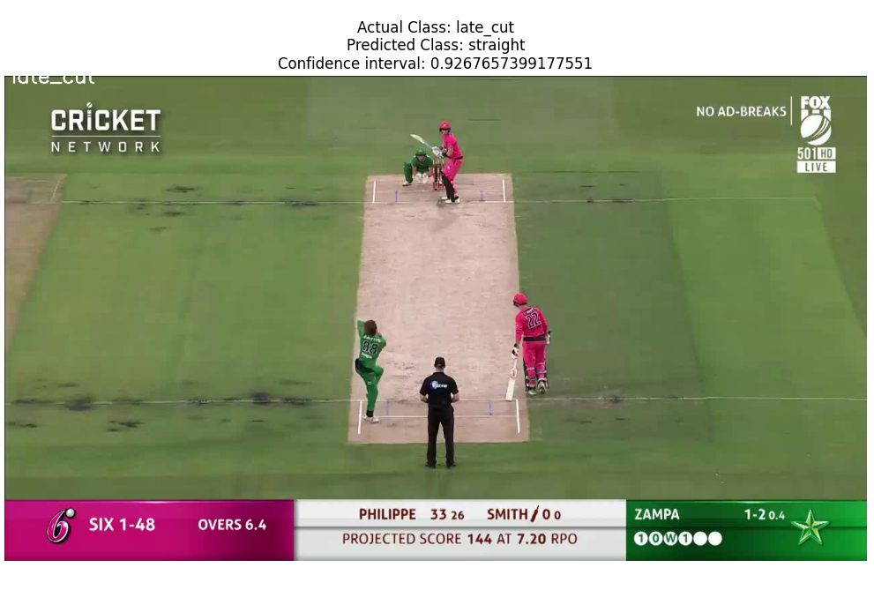
Videos Incorrectly Classified

Slide 25
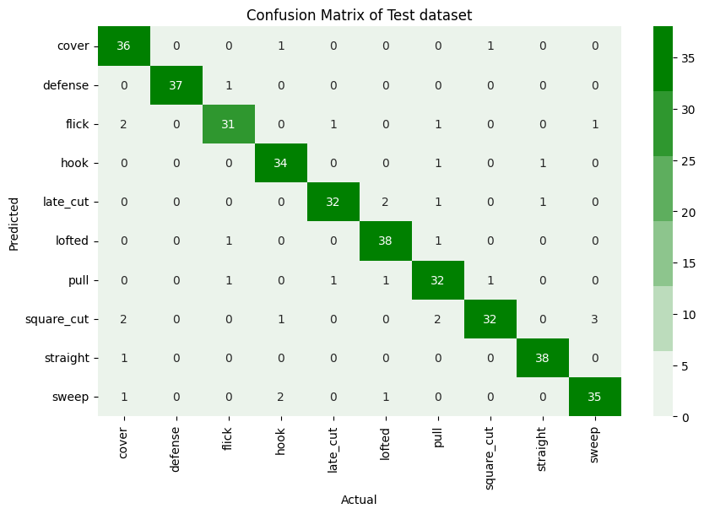
Confusion Matrix for VGG16 (Transfer Learning)
On test set of 378 videos

Slide 26
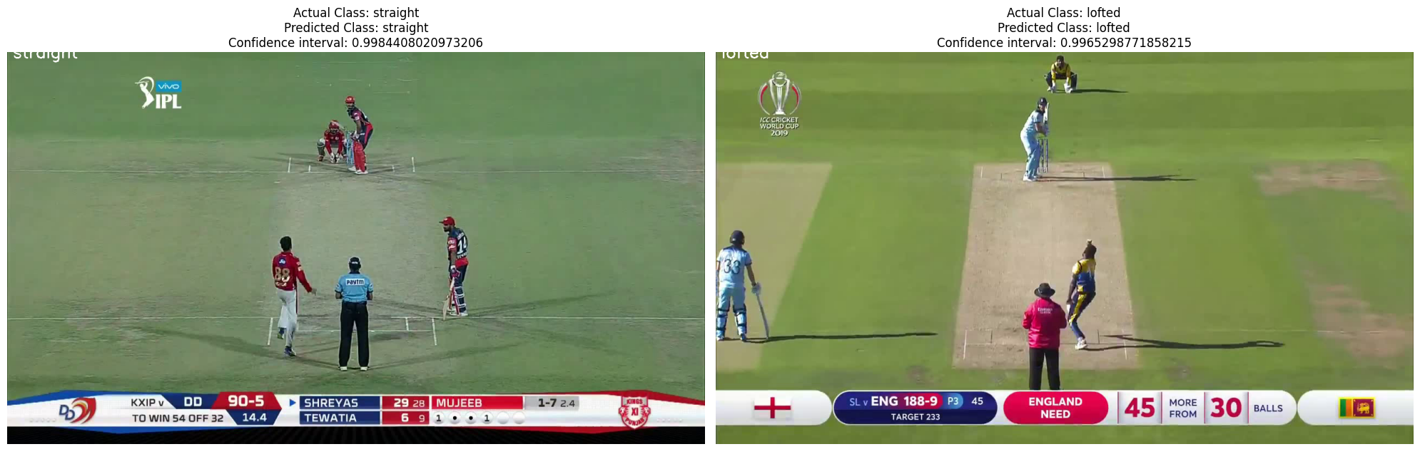
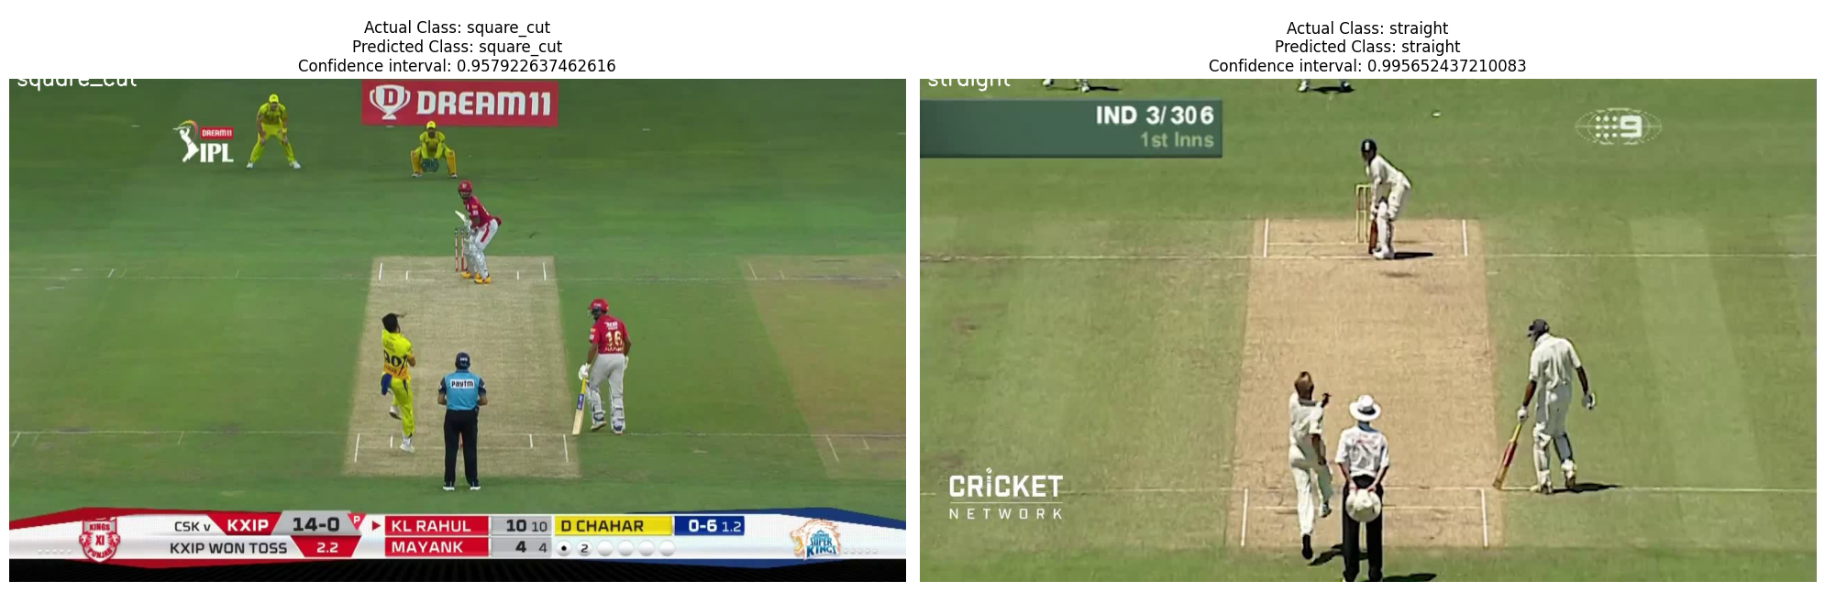
Videos Correctly Classified

Slide 27
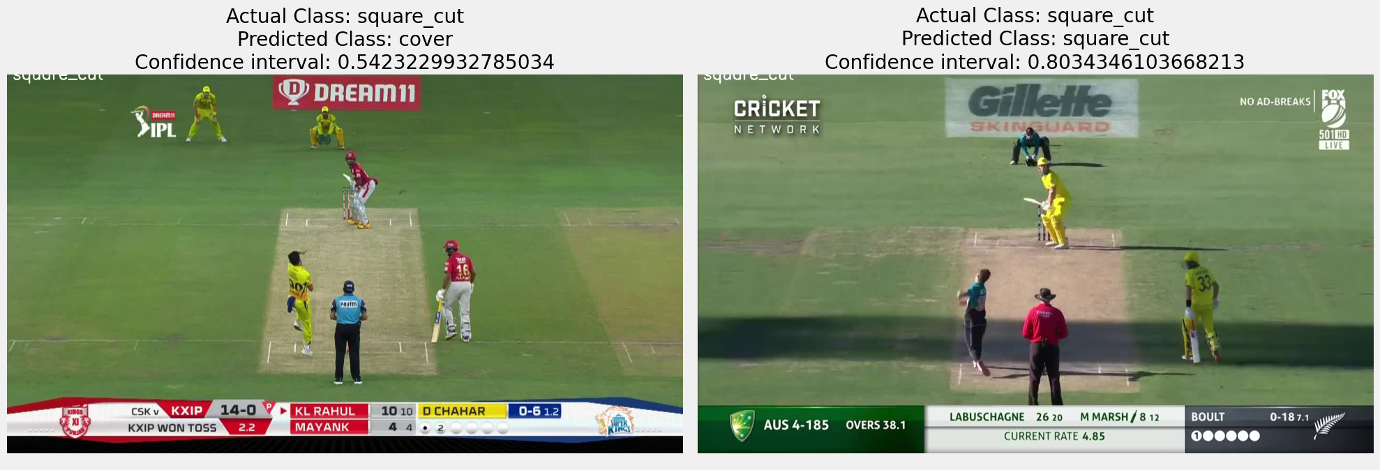
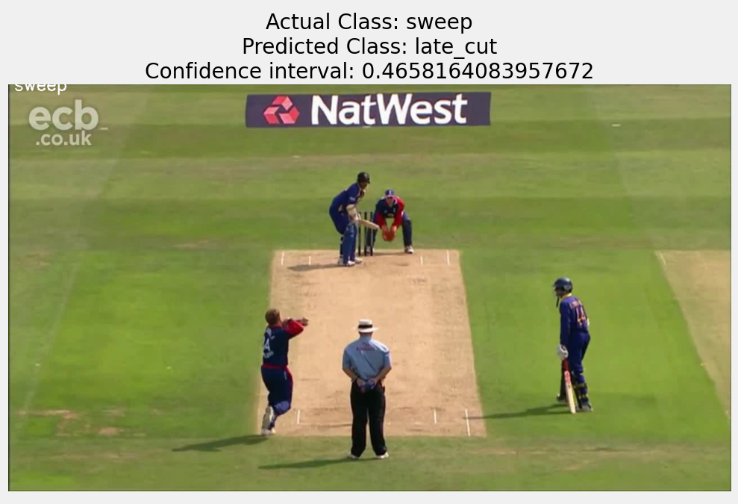
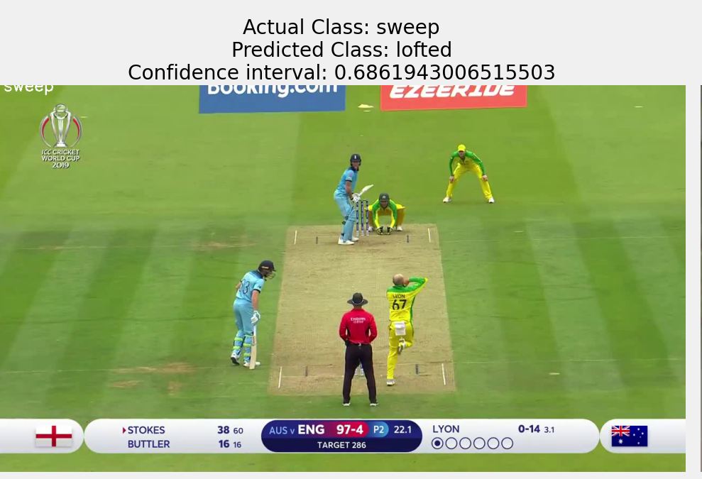
Videos Incorrectly Classified

Slide 28
Comparison of Accuracy
Model | Test Accuracy
2D CNN + LSTM (From Scratch) | 56.4 %
VGG16 (Transfer Learning) | 89.07 %

Slide 29
Model Deployment

Slide 30
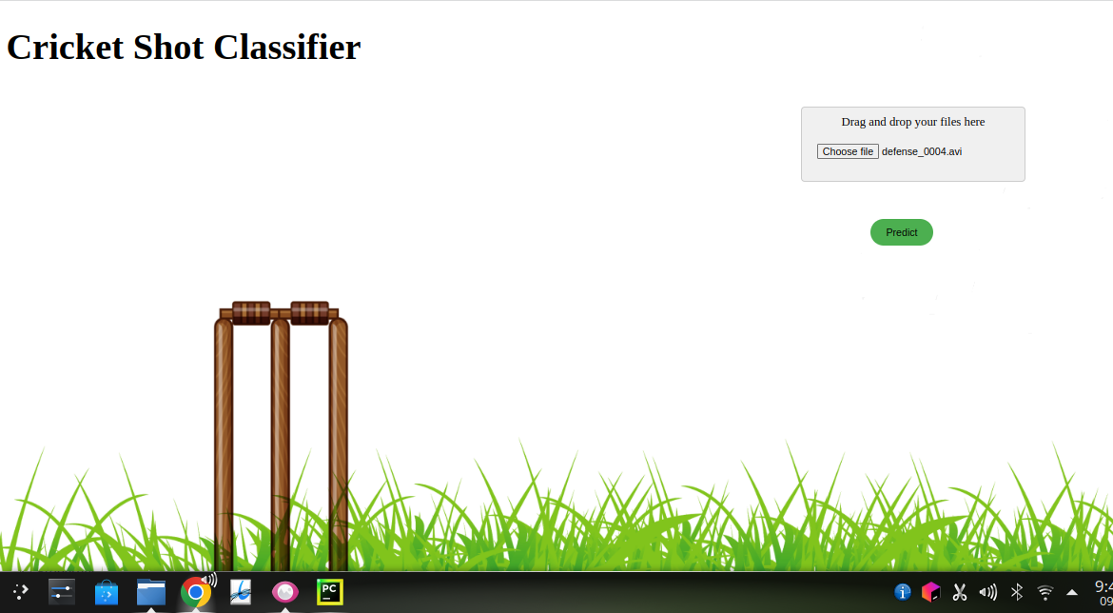
Model Deployment
Simple UI is created to deploy the model
Videos of cricket shots can be uploaded to generate predictions

Slide 31
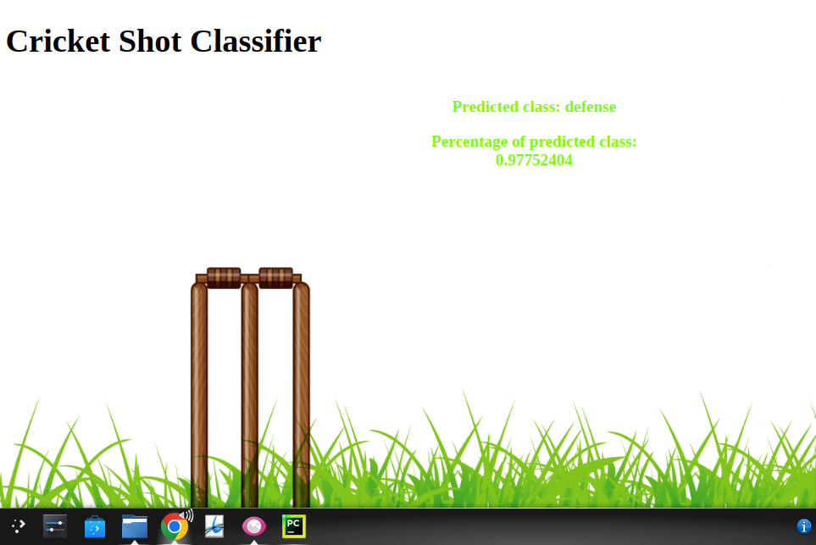
Sample Prediction

Slide 32
Summary
Frame based approaches consider each frame of the video as independent image and extract features accordingly
Sequence based approaches factor in the sequence effect by using a RNN along with a CNN to extract features from a video
3D CNNs consider a video as a 3D image and extract features from it using 3D convolution filters
Models from scratch as well as transfer learning based models were trained for the cricket shot prediction task
Transfer Learning proved to be more effective which is expected due to the complexity of the task involving videos

Slide 33
References
https://www.mdpi.com/1424-8220/21/8/2846
https://cdn.iiit.ac.in/cdn/cvit.iiit.ac.in/images/ConferencePapers/2015/rahulacpr15.pdf
https://gogulilango.com/software/image-classification-python
https://www.kaggle.com/competitions/dfl-bundesliga-data-shootout/discussion/347266
https://towardsdatascience.com/long-term-recurrent-convolutional-network-for-video-regression-12138f8b4713

Slide 34

THANK YOU

